Slide 1
NHL Shot Outcome Prediction Model
Aidan Lee and Max Weinstein

Slide 2
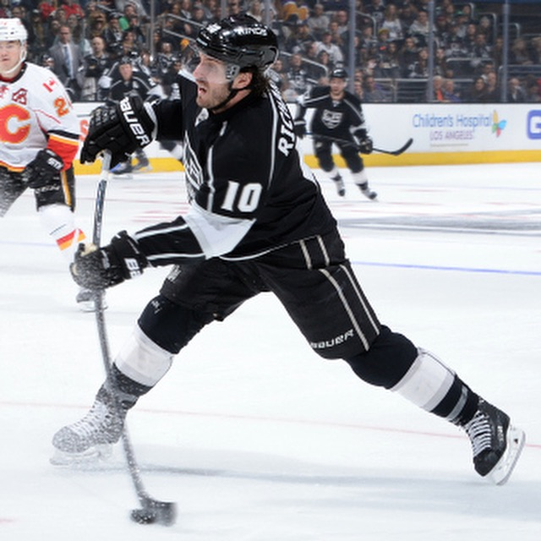
Project Goal
Background:
Hockey is known for being a fast-paced sport where each shot on goal is crucial
In each game, each team takes an average of 30 shots on goal
21 attributes based on:
Shot Data: The distance from the goal, and the angle to the goal
Game Context: Current score, current period, power play
Goal:
Create a model that identifies the most influential attributes and predict shot results
Applications:
Training Tools
In-game & Post-game analysis:

Slide 3
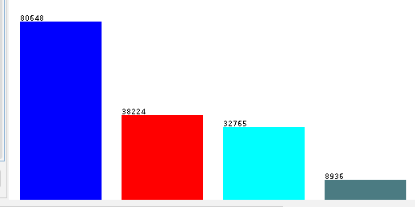
Dataset Description
160,573 instances and 21 attributes
Dataset from SCORE Network Sports Data Repository
Contains every shot from the 2021-22 NHL season
Included info:
Score, Home/Away Teams, Period of Shot, Whether goal was empty
Nominal class variable, shot_outcome:
SHOT: Shot on goal, blocked by goalie
MISSED_SHOT: Shot that missed goal
BLOCKED_SHOT: Shot on goal, blocked by non-goalie player
GOAL: Shot on goal, resulted in goal
Skewed towards missed/blocked goals

Slide 4
Pre-Processing: Removing Unnecessary Attributes
Removed attributes with no significance
Removed attributes:
game_id: ID of the game, Ex: 2021020001
description: A description of the shot, Ex: “Steven Stamkos Wrist Shot saved by Tristan Jarry”
home_name & away_name: Names of teams, Ex: “Tampa Bay Lightning”
event_team: Team of shooter, Ex: “Tampa Bay Lightning”
event_player_1_name & event_goalie_name, event_player_2_name: Names of shooter and goalie/blocker, Ex: “Tristan.Jarry”
event_player_1_type: Type of player, depends on shot outcome, Ex: “Shooter”, “Scorer”
event_player_2_type: Type of second player, Ex: “Goalie”, “Blocker”

Slide 5
Pre-Processing: Removing Null Data
Remove all the missing data
Removed:
shot_distance & shot_angle (38,224)
(BLOCKED_SHOT)
strength_code (303)
empty_net, having 111,742 instances
Random Sampling Based on Proportions
[517, 7,994] true/false to [7,272, 112,981]
Random seed of ‘20241009’

Slide 6
Pre-Processing: Transforming Data
Transformations:
empty_net: “TRUE” / “FALSE” -> True/False
game_seconds_remaining:
Removed negative values
min-max normalization
period_seconds_remaining: min-max normalized
x_fixed & y_fixed: z-score normalized
shot_distance: z-score normalized

Slide 7
Pre-Processing: Splitting Data
Split data randomly, keeping proportions:
65.9681% SHOT
26.8541% MISSED_SHOT
7.1793% GOAL
Random seed used: “20241002”
84,177 instances in training set
Notes:
18,038 -> 36076

Slide 8
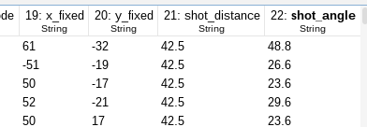
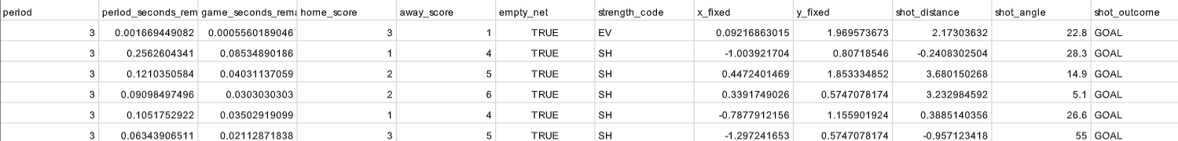
Initial → Pre-processed Data
Initial:
Pre-processed:

Slide 9
Attribute Selection Algorithms
CfsSubsetEval, top 6:
home_score, away_score, strength_code, x_fixed, y_fixed, shot_distance
InfoGainAttributeEval, cutoff value: 0.003:
shot_distance, x_fixed, y_fixed, home_score, away_score, shot_angle, strength_code, game_seconds_remaining
CorrelationAttributeEval, cutoff value: 0.015:
shot_distance, away_score, home_score, strength_code, shot_angle
GainRatioAttributeEval, cutoff value: 0.003:
shot_distance, x_fixed, y_fixed, home_score, strength_code, away_score, period_seconds_remaining
Mutual Information:, cutoff value: 0.01:
shot_distance, x_fixed, y_fixed, shot_angle

Slide 10
Classifier Models
Four classifier models:
trees.J48: Builds a C4.5 decision tree
bayes.NaiveBayes: Classification that is based on Bayes’ Theorem and assumes independence between attributes
rules.OneR: Generates rules based on each separate attribute to predict class, for each attribute, chooses the rule that provides lowest error rate
trees.RandomTree: Decision tree algorithm, chooses attributes at random
Ran each model with every dataset produced by the attribute selection algorithms

Slide 11
Accuracies
 | J48 | NaiveBayes | OneR | RandomTree
CfsSubset | 66.0217% | 65.2012% | 65.9663% | 54.7334%
InfoGain | 64.9296% | 64.8312% | 65.3177% | 53.6645%
Correlation | 66.0439% | 65.3565% | 65.9330% | 57.2126%
GainRatio | 65.2234% | 65.1236% | 65.9663% | 53.4594%
Mutual Info | 65.9663% | 65.9663% | 65.9330% | 61.9914%

Slide 12
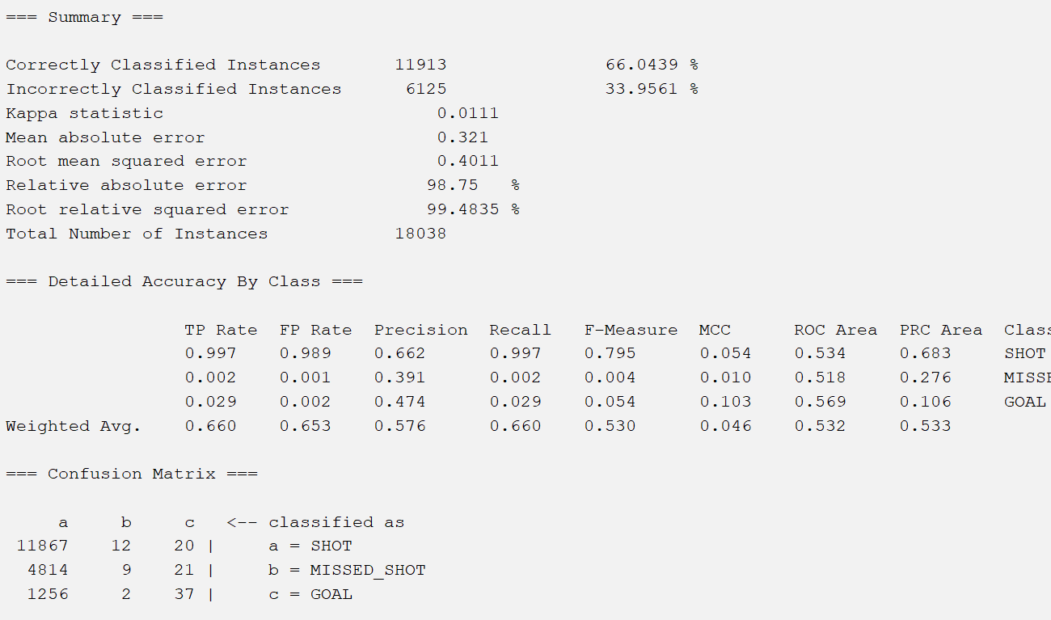
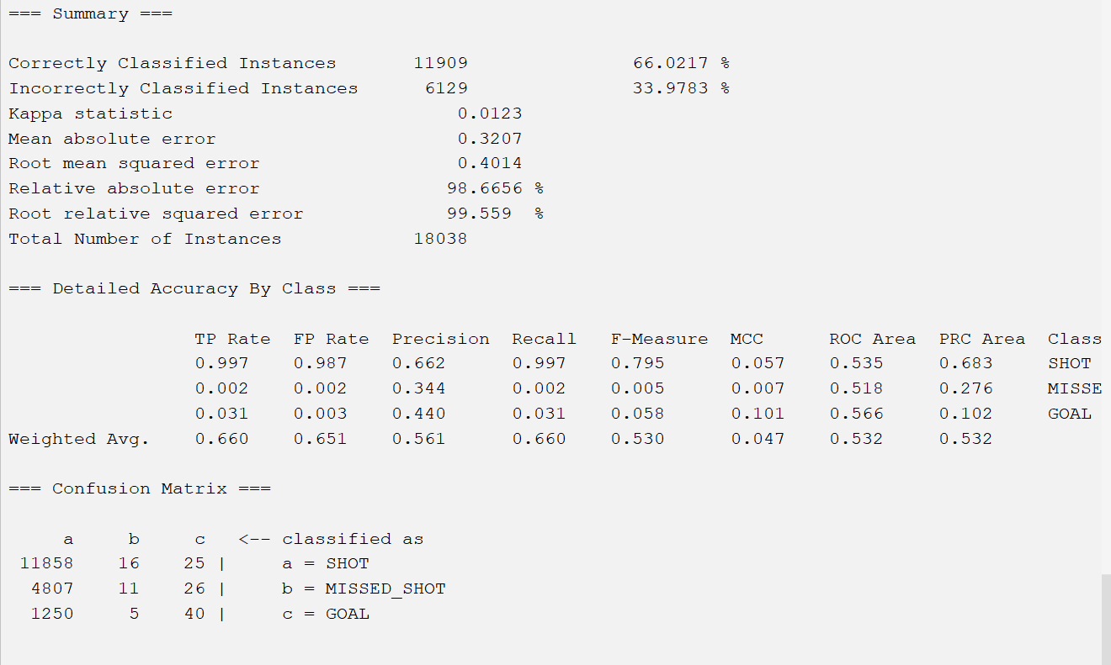
Results
Best Results:
CorrelationAttributeEval with J48
CfsSubsetEval with J48

Slide 13
Analysis
We had 20 different models
RandomTree had the worst accuracies with an average of around 56.2123%
J48 had the best accuracies with an average of around 65.6370%
Our best model was CorrelationAttributeEval with J48.
Accuracy: 66.0439%
11913 correctly identified instances
The error for the CorrelationAttributeEval with J48 model is less than the error for the CfsSubsetEval with J48
Low accuracy due to three classes: blocked shot, missed shot, and goal.
Unpredictability in sports affects outcomes.
Players may miss easy shots or score on unexpected attempts.

Slide 14
Conclusion
Our final chosen model is CorrelationAttributeEval with J48, best results out of all 20 models
We created a model that provided us with decent results, although we feel like they could have been better.
Ways we can improve:
Using combined attributes can get better results

Slide 15
How to Reproduce Model
Open WEKA and load the explorer.
In the explorer, open the file train_set.csv.
This file was already processed, so you don’t need to change anything about the data
Go to the “Select attributes” tab
In the class selection dropdown (defaults as “No class”), choose our class variable: “(Nom) shot_outcome”
Choose “CorrelationAttributeEval” from the selection in the Attribute Evaluator dropdown, and it will automatically pick “Ranker” as the search method
Click Start

Slide 16
How to Reproduce Model (p2)
Write down which attributes pass the threshold of 0.015, then go over to the Preprocess tab, and remove every attribute that doesn’t, by selecting them and clicking remove. Make sure to keep the class variable. For these sets, we end up with the following attributes: home_score, away_score, strength_code, shot_distance, shot_angle, shot_outcome
Save this dataset as an arff file.
Open the file test_set.csv
Remove attributes to attain the same features as the training dataset, and save the dataset as an arff file
Open the Explorer and load the training dataset arff file
Go to the “Classify” tab, under options click “Supplied test set”, and load the test dataset arff file. Make sure to select the correct class variable (“shot_outcome”)
Make sure to have the correct class on the class dropdown (defaults to “No class”)
Under the Classifier dropdown, go Trees -> J48
Click start, and if it asks to wrap the classifier in a “InputMappedClassifier”, select “Yes”

Slide 17
References and Sources
Data source website: https://data.scorenetwork.org/hockey/nhl-shots.html
Additional files:
nhl-shots-2021.csv — The raw dataset before altering anything.
shots_final.csv — The dataset after preprocessing. All the unnecessary attributes and missing values are removed. Additionally, some data is normalized.
test_set.csv, train_set.csv, val_set.csv — The training, testing, and validation sets before the attribute selection
best_model (dir) - files used by the best model

